Slide 1

Woven Together:
A System Guide for Stephanie’s Creations
Presented by: Hannah Clark | Heather Siler | Lauren Geis
Notes:
Presenter: Lauren
Transition to next Presenter: NA this slide

Slide 2
Reduced Manual Effort
200+ hours a year
$5,000 in saved labor
Streamlined Inventory Management
30% reduction in inventory costs
$900 in saved COGs
Scalable Solution
Manage 3x more orders
$20,000 increase in annual revenue
Faster Response Time
50% faster response time – increase in customer conversion rate
10 extra sales @ $40 per order = $400 in added revenue
Notes:
Presenter: Lauren
Transition to next Presenter: NA this slide

Slide 3
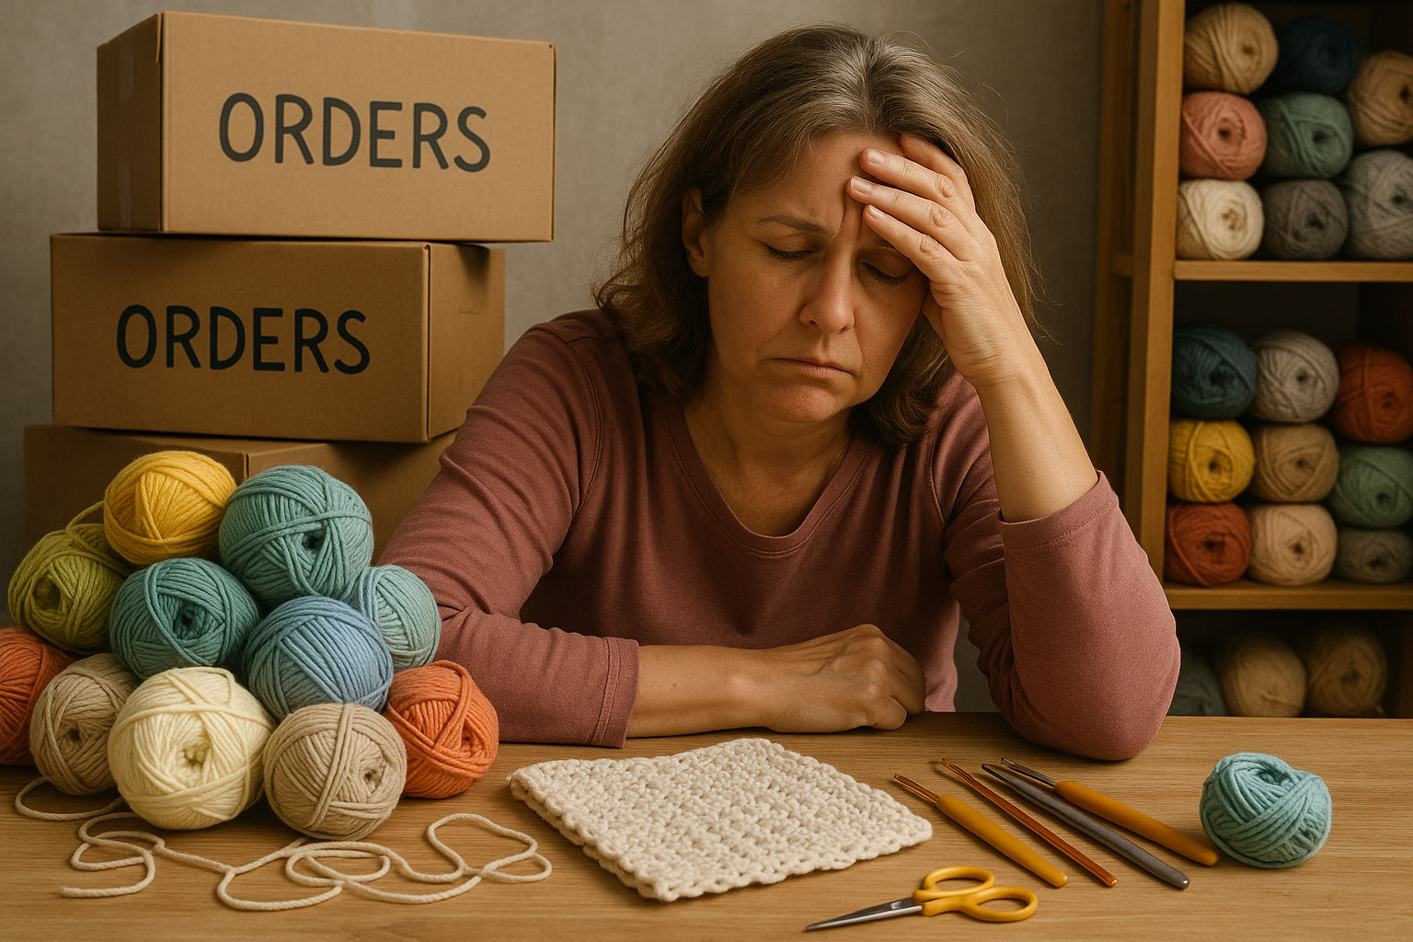
Stephanie’s
Problem
No centralized system
Customer satisfaction
Manual processes
Scalability
Fulfillment logistics
Payment processing
Notes:
Presenter: Lauren
Transition to next Presenter: NA this slide

Slide 4

Stephanie’s
solution
User Friendly Interface
Inventory
Management
Sales/Order Tracking
Payment Processing
Reduce manual effort by 80%
50% faster inventory updates with low-stock alerts
24/7 order tracking visibility
100% increase in electronic payments
Support 3x more orders with less effort
50% faster response time to customers
Owner access to funds to transfer
Reduce COGS by 30% in the first 90 days, with ongoing savings
Centralized Web Application
Business Process
Improvement
Notes:
Presenter: Lauren
Transition to next Presenter: NA this slide

Slide 5
Notes:
Presenter: Lauren
Transition to next Presenter: NA this slide

Slide 6
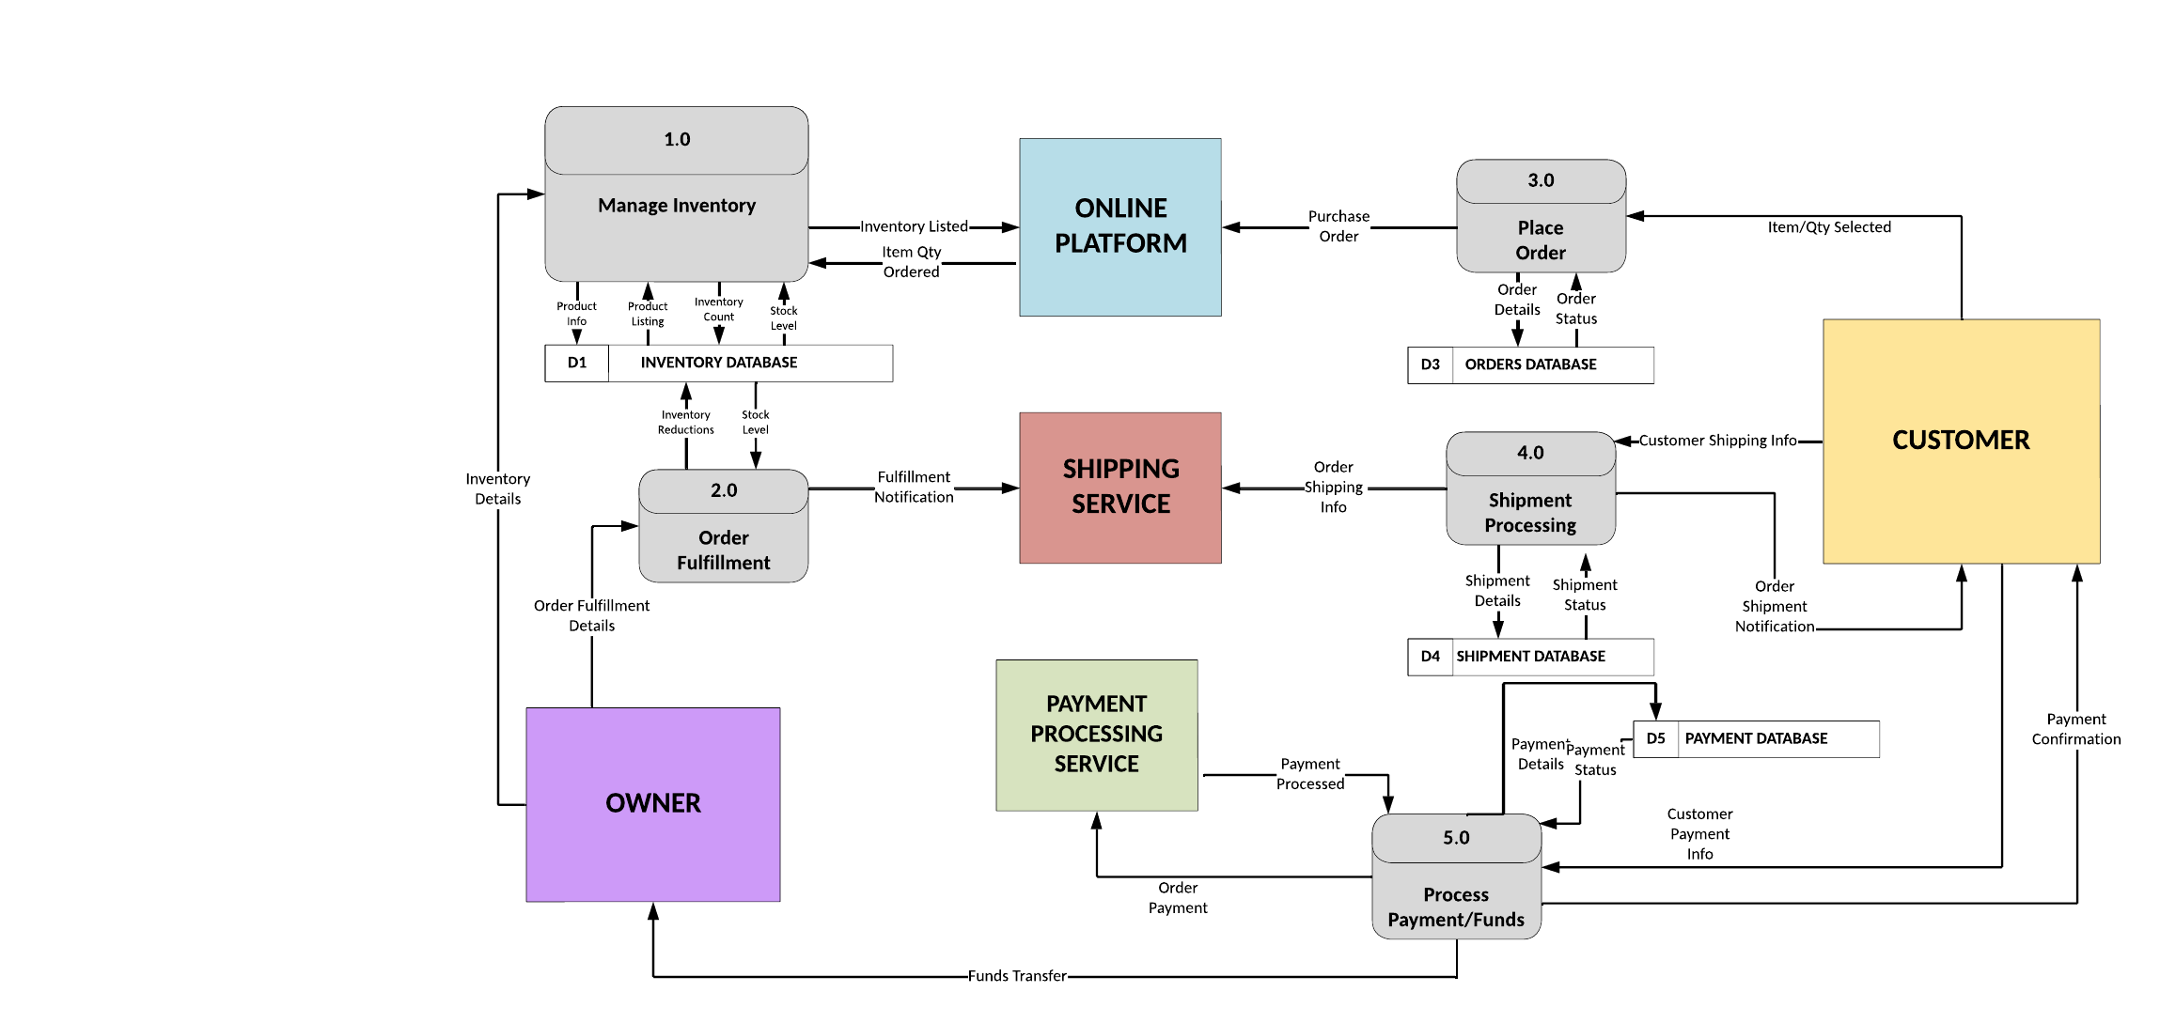
Notes:
Presenter: Lauren
Transition to next Presenter: NA this slide

Slide 7

From Pieces to Pattern:
Watch it work!
Notes:
Presenter: Lauren
Transition to next Presenter: NA this slide

Slide 8
Lessons Learned
Designing for clarity and ease of use was more valuable than adding complexity
Each member owned key parts based on their strengths
Sprints and check-ins kept us on track and adaptable
Great presentations tell a story – not just display words
User simplicity > Feature Overload
“Divide and Conquer” Works Best With Trust
Agile Works – With Discipline
Storytelling Over Slides
Notes:
Presenter: Lauren
Transition to next Presenter: NA this slide

Slide 9
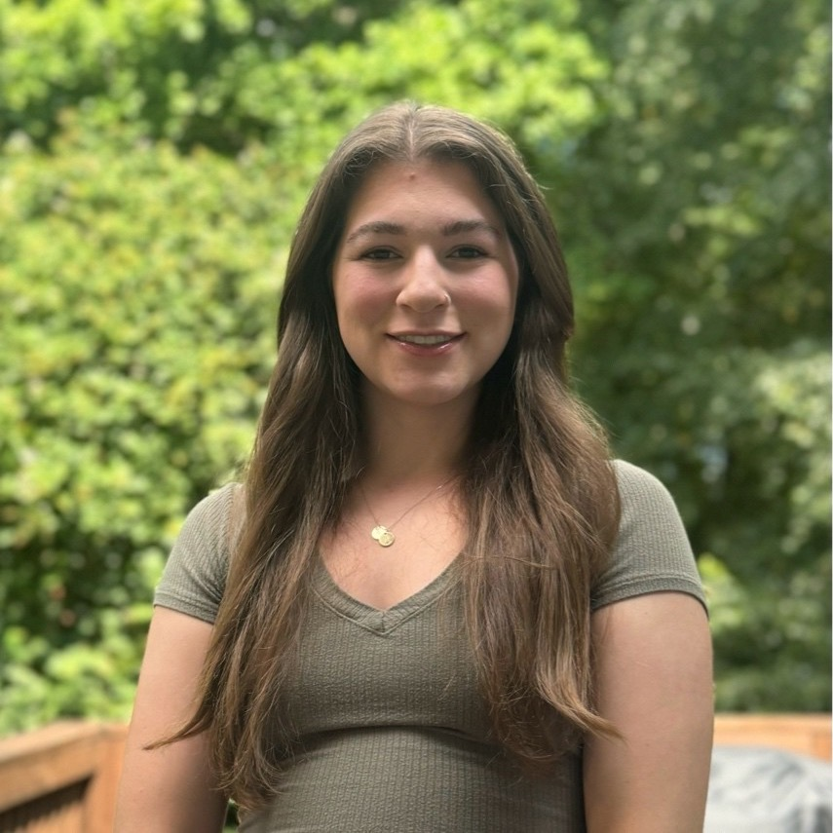
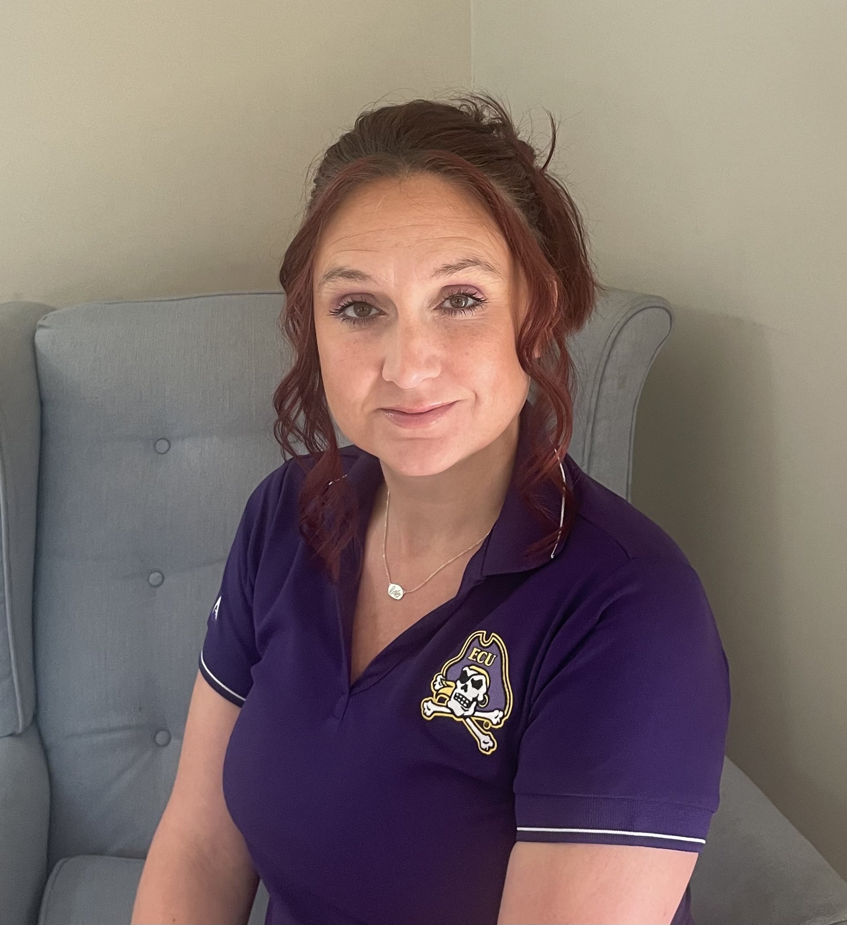
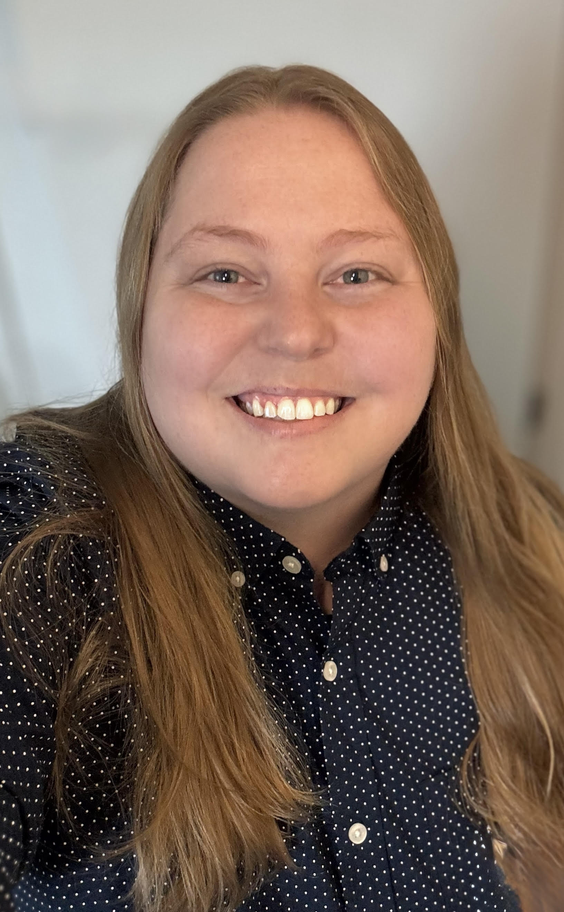
Challenges, Problems & Discoveries
Hannah Clark – Database/Programming Coordinator
C/P: Database/coding
Discovery: Firebase and Firestore
Heather Siler – Co-owner/Project Manager
C/P: Weaving it altogether
Discovery: College of Business + Management Information = Complete SDLC
Lauren Geis – Systems Analyst
C/P: Looping technical needs into a pattern that makes sense
Discovery: The system works when it’s presented in a way the user understands
Notes:
Presenter: Lauren
Transition to next Presenter: NA this slide

Slide 10
Woven Together:
THANK YOU!
Stephanie’s Creations 2.0
Notes:
Presenter: Lauren
Transition to next Presenter: NA this slide

Slide 11
Notes:
Presenter: Lauren
Transition to next Presenter: NA this slide
Speaking Points
Good evening everyone! Our goal today is to provide a detailed story and demonstrate the value we've delivered in this sprint. We'll focus on how these deliverables contribute to the overall project objectives.
The value delivered in this Sprint will be realized in future construction of our IS for Stephanie. Once created and implemented our it will save her an estimated 200 hours annually in Inventory Management, Sales and Order Processing, Financial Reporting and Customer Communication.
This time can be reinvested into product creation, marketing, and business growth. We expect Stephanie to increase sales by 20% within the first year of implementing the IS we are creating for her this semester

Slide 12
Notes:
Presenter: Lauren
Transition to next Presenter: NA this slide

